Slide 1
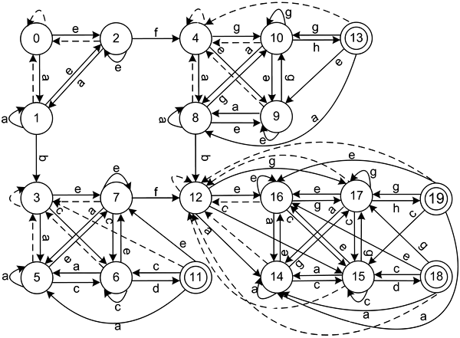

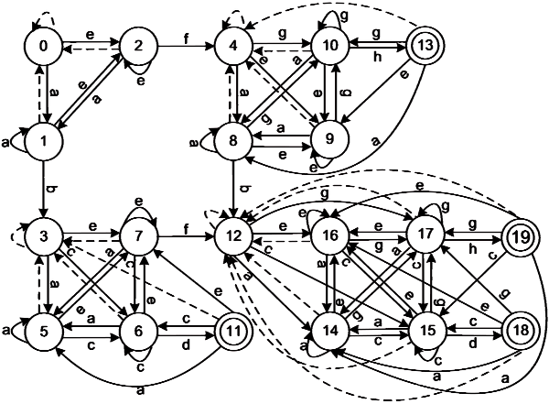
MINIMIZATION
OF DFA
LANGUAGE THEORY AND COMPILATION
PRESENTED BY
SOULAIMANE ED-DAHMANI

Slide 2
CONTENT TABLE
01
Definition and objective
02
DFA minimization methods
03
Partition method
04
C programming

Slide 3



DEFINITION
Is the process of reducing the number of states in a given DFA while conserving the same properties.
OBJECTIVE
Reducing resources usage in term of memory, processing power and compilation time.

Slide 4
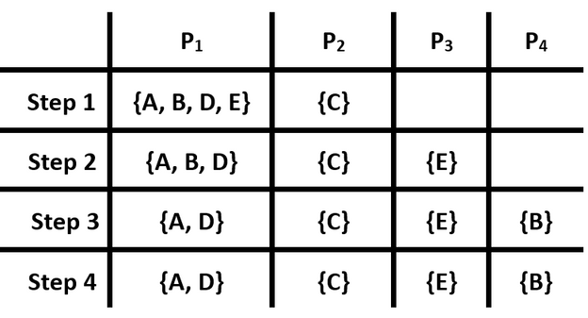
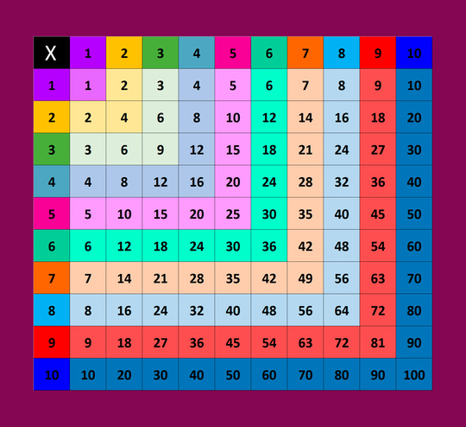


DFA MINIMIZATION METHODS
There are a lot of methods to minimize a DFA
We can use :
Partition Refinement
Myhill-Nerode Algorithm
Brzozowski’s Algorithm
Hopcroft’s Algorithm

Slide 5




PARTITION REFINEMENT
at
Remove Unreachable States
Initial Partition
Initial Partition
Remove Unreachable States
Refine the Partition
Merge equivalent states
We generate all possible pairs of states in each class, then we apply the input symbols on each pair and compare the results in order to identify if we have equivalent or distinguishable states.
We create two classes :
A) Final states : This will present all final states
B) Non-final states : This will present all Non-final states.
We create two classes :
A) Final states : This will present all final states
B) Non-final states : This will present all Non-final states.
We delete all states that cannot be reached from the intial state.
We delete all states that cannot be reached from the intial state.
We merge all equivalent states into a single state and construct the new minimized DFA.

Slide 6
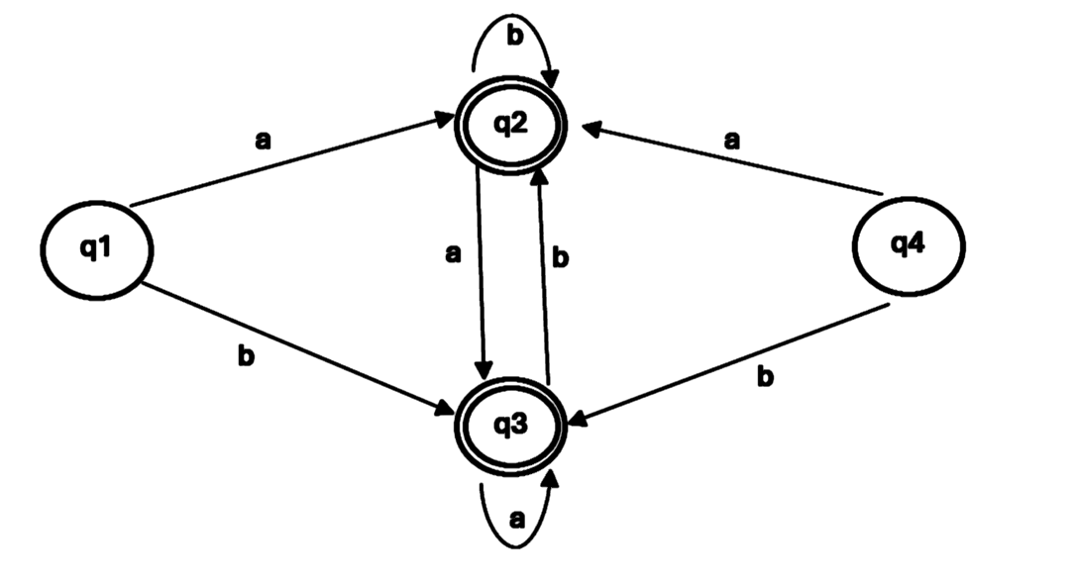

at
EXEMPLE

Slide 7


at
1. Remove Unreachable States

Slide 8
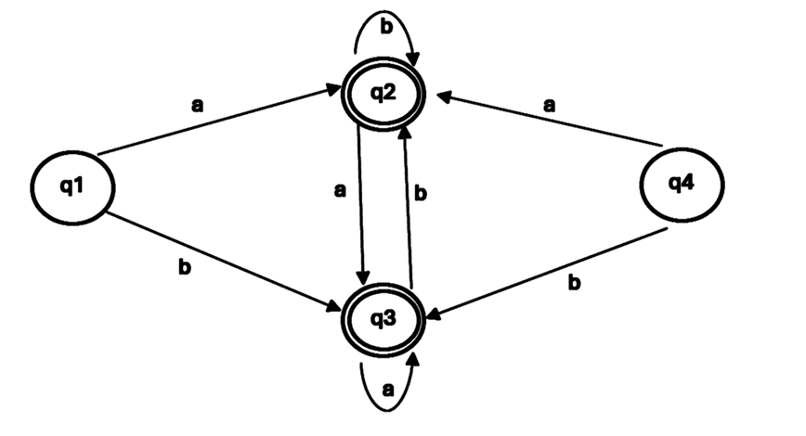

at
1. Remove Unreachable States
q4 is an unreachable state ,so remove it
at

Slide 9
2. Initial partition
at
Class A
Final states : q2, q3
→ Class A = { q2, q3 }
Class B
Non-Final states : q1
→ Class B = { q1 }

Slide 10

3. Refinement
Class A
Final states : q2, q3
→ Class A = { q2, q3 }
(q2,q3)
Class B
Non-Final states : q2, q3
→ Class B = { q1 }
No pair

Slide 11



3. Refinement
at
(q2,q3)
a
q3
q2
The result is identical, so q2 and q3 are equivalent states and we can merge them.
b
q2
a
q3
q3
b
q2

Slide 12
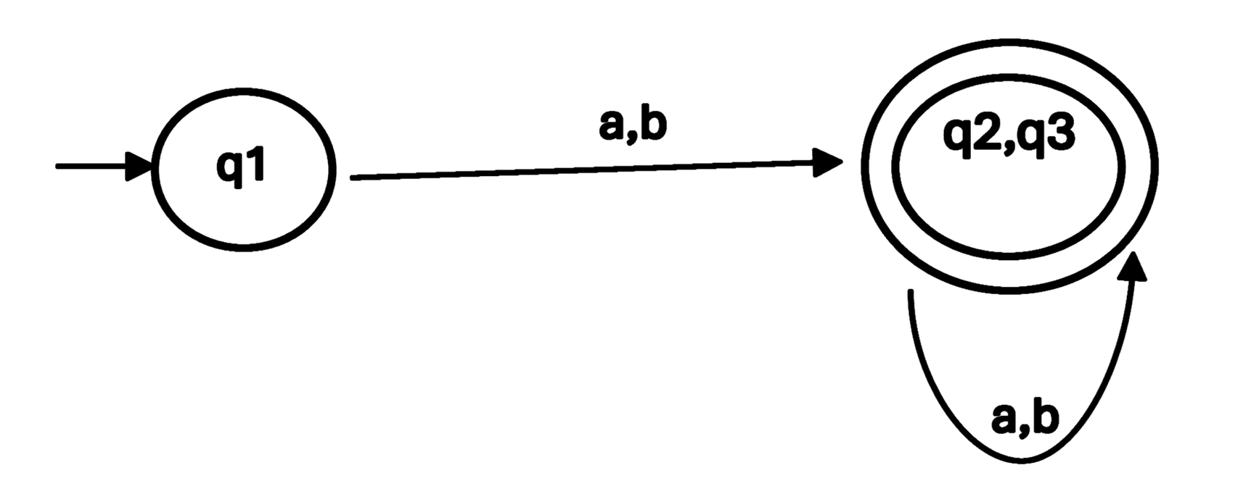
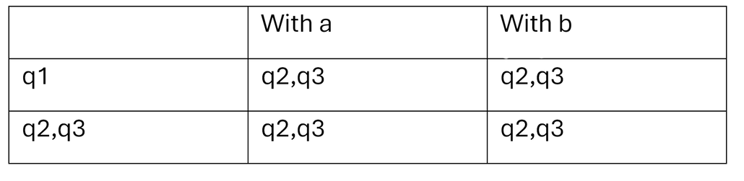
at
4. Merge equivalent states
We merge q2 and q3
The final result

Slide 13



PROGRAMMING

